Slide 1
Preventing Prescription Opioid Misuse
Texas Targeted Opioid Response
PRESENTERS NAME

Slide 2
Presenting Organization
PRESENTED BY
Texas Targeted Opioid Response

Slide 3
Agenda
Opioid Crisis in Texas
What Are Opioids?
What Are the Risks?
Myth vs. Fact & Misconceptions
Actions You Can Take

Slide 4
“One in four Texans has experienced an opioid overdose or knows someone who has.”
- Based on results from panel surveys conducted in 2020 and 2021 with a total of 3,347 adult participants throughout the state of Texas. Participants were selected to reflect current Texas demographics, including age, gender and ethnicity.

Slide 5
Texas Facts & Figures
01

Slide 6
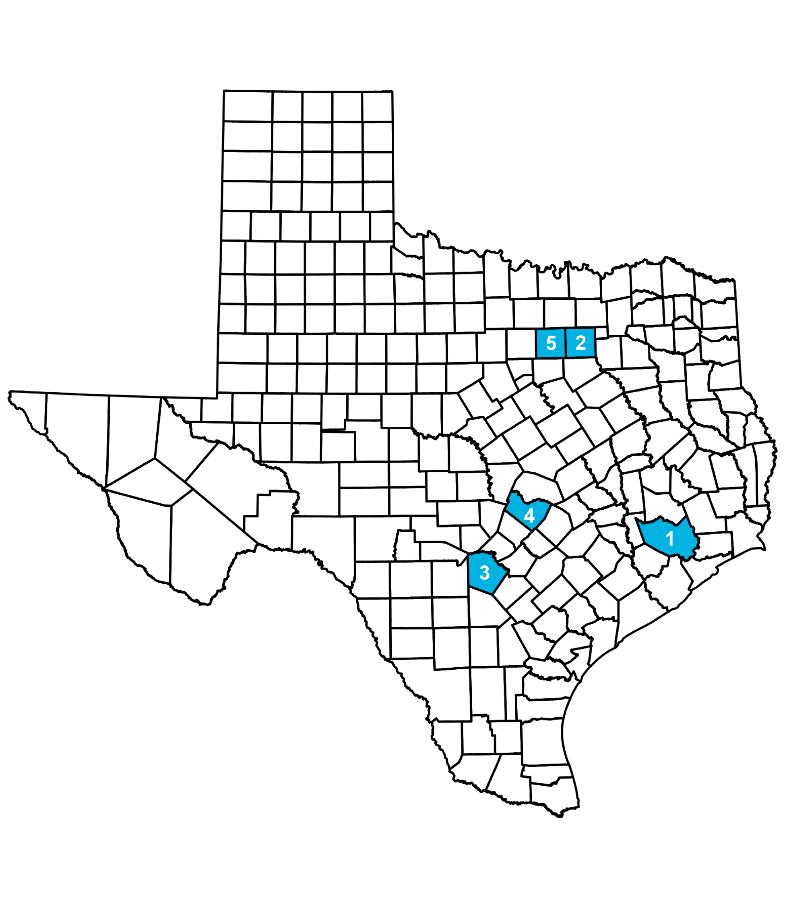
One in four Texans has experienced an opioid overdose or knows someone who has.
Top five counties in Texas with the highest counts of opioid overdose deaths as of 2019:
Harris County
Dallas County
Bexar County
Travis County
Tarrant County
Prescription drug overdose is a leading cause of maternal mortality in Texas (Texas Health and Human Services).
Nearly one in five Texas high school students have taken prescription drugs without a doctor’s prescription (Texas Health and Human Services).
In 2020, nearly 92,000 people died from drug overdoses, making it a leading cause of injury-related death in the United States. Of those deaths, nearly 75% involved a prescription or illicit opioid. Drug overdose deaths continue to increase in the United States (Centers for Disease Control and Prevention).

Slide 7
Regional Data
REGION NAME
You can present regional data specific to your organizations area here.
See HHS Texas Health Data: https://healthdata.dshs.texas.gov/dashboards/drugs-and-alcohol/opioids/
Titles and subtitles can be changed

Slide 8
What Are Opioids?
02

Slide 9
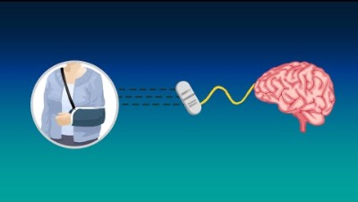
INSERT VIDEO: SEE HOW PRESCRIPTION OPIOIDS WORK

Slide 10
Prescribed to help with pain from
Prescription opioids are a class of powerful pain management medications.
A serious injury
Surgery
C-section birth
Cancer and more
Some examples of brand names include
Lortab
Ultram
Tylenol with Codeine
Percocet
Vicodin
OxyContin

Slide 11
What Are The Risks?
03

Slide 12
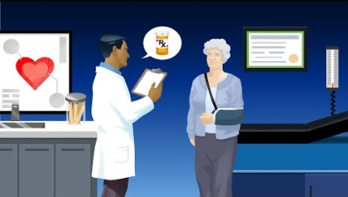
INSERT VIDEO: LEARN THE RISKS OF OPIOID MISUSE

Slide 13
Your body and brain quickly get used to the medication
Your body can become dependent on prescription opioids after just seven days, potentially setting you on a path toward addiction.
The prescribed amount becomes less and less effective.
You would need more to manage the pain, which increases the risk of misuse and overdose.
Look for signs of withdrawal after physical dependence
Insomnia
Anxiety
Nausea
Muscle aches
Restlessness

Slide 14
Misuse is taking opioids any way other than what is prescribed by a doctor
Opioids are powerful medications for people with severe pain but misusing them can be dangerous or even deadly.
Taking more than prescribed
Taking them without a prescription
Any non-medical use
Taking more than necessary can lead to dangerous side effects
Over sedation
Slowed breathing
Overdose
Death

Slide 15
Overdose can happen when a person
Learn the signs of an overdose.
Intentionally or unintentionally takes too much of an opioid.
Mixes opioids with other drugs or alcohol at a level that is toxic to the body
Signs of an overdose
Very small pupils
Unconscious
Face is extremely pale or feels clammy to the touch
Body goes limp
Fingernails or lips have a purple or blue color
Vomiting or making gurgling noises
Cannot be awakened or are unable to speak
Breathing or heartbeat slows or stops
Notes:
Add new slide after current slide 15: (Use naloxone picture from Chris) How to Respond to an Overdose 1. Call 911 right away 2. Try to wake the person up 3. Give naloxone, if available 4. Begin rescue breathing or CPR 5. Turn the person on their side to prevent choking 6. Stay with the person until emergency services arrive

Slide 16
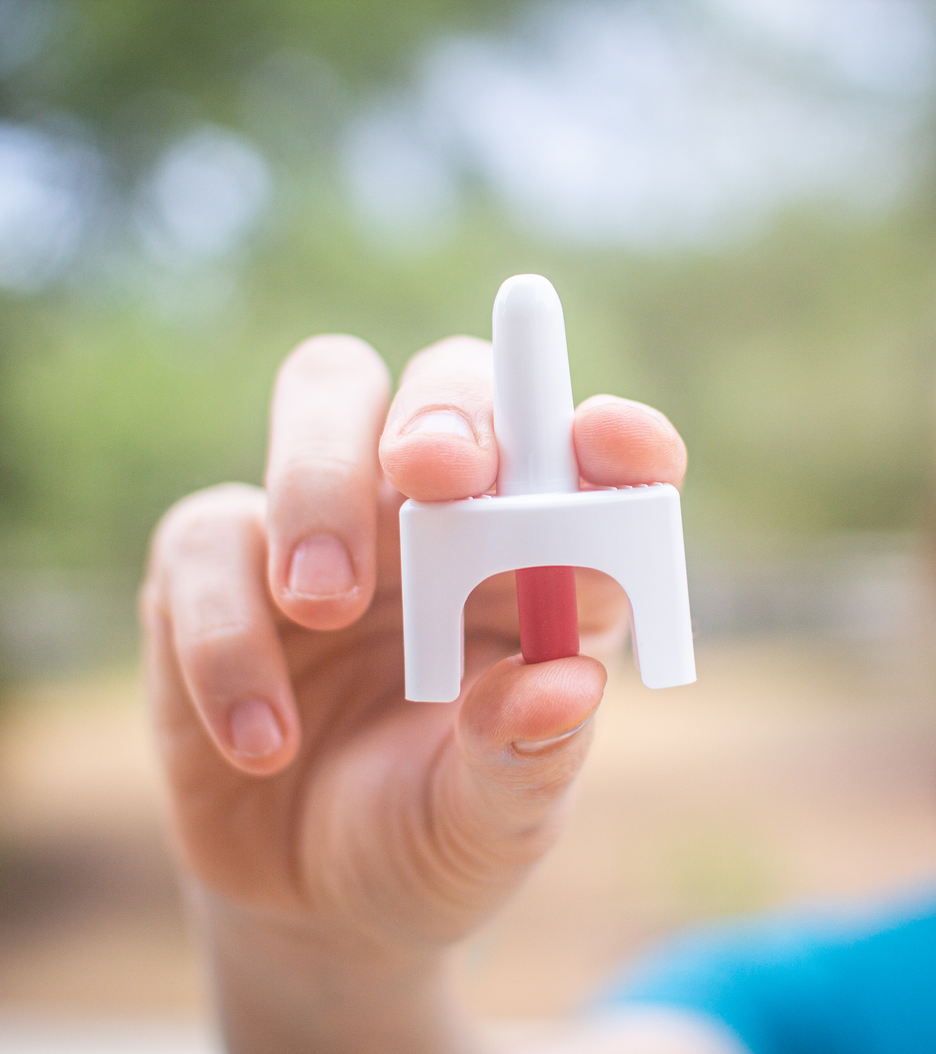
How to respond to an overdose
Call 911 right away
Try to wake the person up
Give naloxone, if available
Begin rescue breathing or CPR
Turn the person on their side to prevent choking
Stay with the person until emergency services arrive

Slide 17
Common Misconceptions
04

Slide 18

Fact vs. Myth
Any use of prescription opioids is unsafe.
Myth
When taken as directed, prescription opioids are one way to manage severe short-term and chronic pain.
Fact

Slide 19

Fact vs. Myth
The language and words that we use when talking about substance use doesn’t matter much one way or the other.
Myth
When talking about opioids our words do matter. Language that labels or blames people experiencing opioid use disorder can cause harm and make them feel ashamed, alone or helpless, and less likely to seek help.
Fact

Slide 20
Words to Avoid
Drug user, abuser, doing drugs
Doctor shopping
Addict, pill popper, junkie
Clean, dirty

Slide 21

Words to Use
A person who misuses medication
Medication-seeking behavior
A person with opioid use disorder
Negative, positive, substance-free

Slide 22

Fact vs. Myth
Texas doesn’t notice the opioid crisis as an issue of concern and treatment is hard to find.
Myth
The opioid crisis is a big priority for Texas. There are a variety of state and national resources available to help get you started on a path to treatment and recovery.
Fact

Slide 23
Actions You Can Take
05

Slide 24
How You Can Help
If you are prescribed opioids by a doctor
Only take your medication exactly as prescribed.
Never increase, cut back or stop taking your medication before talking to your doctor.
Keep your medications in a place where children and other family members cannot access them.

Slide 25
How You Can Help
Having naloxone on-hand to reverse bad reactions or accidental ingestion can save someone’s life
Naloxone blocks the effects of opioids and rapidly reverses overdose.
It works by helping someone who is unresponsive to breathe normally again.
Naloxone has no effect if opioids are not present in a person’s system.
How to get naloxone
You can ask for naloxone without a prescription at any pharmacy in Texas.

Slide 26
How You Can Help
For anyone struggling with opioid addiction, help is available
2-1-1 Texas: Connection to services and resources in your community
2-1-1
SAMHSA 24/7 National Helpline: Treatment referrals for individuals and families facing substance use disorders or mental health issues
1-800-662-HELP (4357)
9-8-8 Suicide & Crisis Lifeline: If you are considering suicide, call this number to talk to a crisis counselor for confidential emotional support 24/7
9-8-8
Explore other resources to get started on a path to treatment and recovery at https://txopioidresponse.org/get_help

Slide 27

How You Can Help
If you plan to talk to a friend, child or loved one about their opioid use
Be specific. Explain what you observed that made you concerned, without making accusations.
Ask open ended questions to create a two-way dialogue and listen as much as you talk.
Express how much you care about them and reassure them that you can be counted on for support.

Slide 28
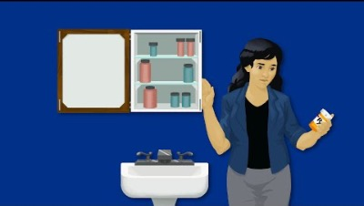

Slide 29
Treatment is available and recovery is possible
No one sets out to be addicted to opioids. Addiction is a disease that can affect anyone. Everyone deserves help.
PRESENTER CREDENTIALS AND CONTACT INFO

